Slide 1
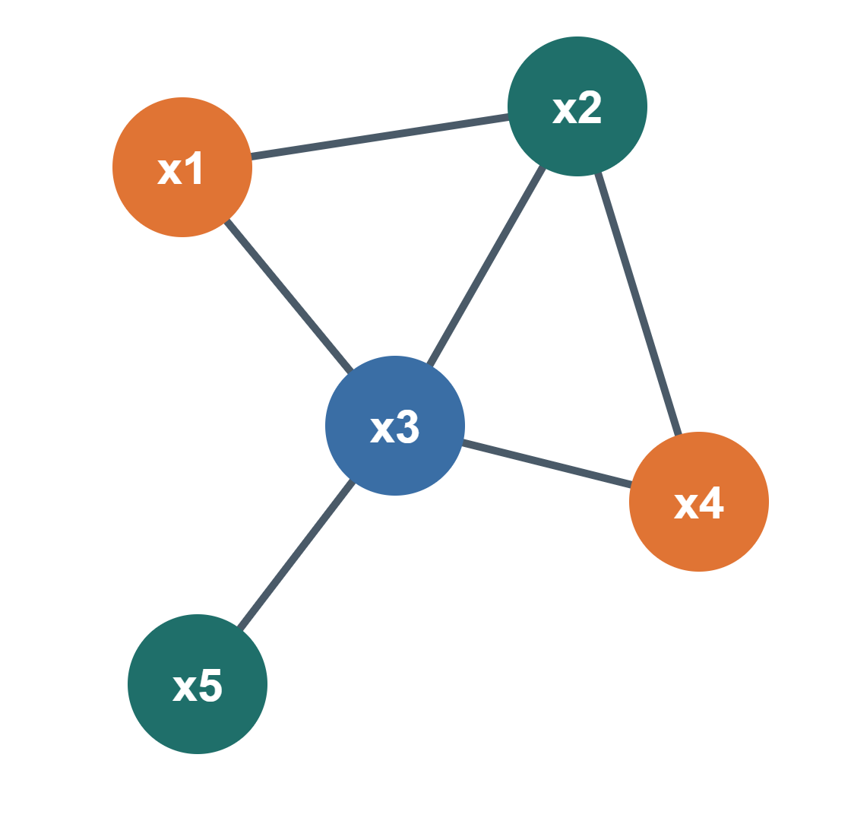
CONSTRAINT PROGRAMMING · SEMESTER 3 · UEM3
Chapter 1
Introduction to Constraint Programming
Paradigms · CSP definitions · Worked examples · Applications
S.HABOUSSI· Université Akli Mohand Oulhadj Bouira

Slide 2
LEARNING OBJECTIVES
By the end of this chapter, you can…
01
Contrast two paradigms
02
Define a CSP
Explain how declarative programming differs from imperative programming.
State the triple (X, D, C) and the terms variable, domain, constraint, solution.
03
Model small problems
04
Spot CP problems
Translate a word problem into variables, domains and constraints.
Recognise planning, timetabling, configuration and allocation tasks.
Constraint Programming · Chapter 1
1

Slide 3
1.1 · PARADIGMS
Imperative vs declarative programming
In programing there is two types of programing paradigms:
  Imperative: in this paradigm we just step by step How to do something
  Declarative:in this paradigm We just describe what we want
Constraint Programming · Chapter 1
2

Slide 4
1.1 · PARADIGMS
Imperative vs declarative programming
Task: find The sum of numbers in list
Imperative — you write HOW
Declarative — you write WHAT
total = 0
my_list = [1, 2, 3, 4, 5]
for num in my_list:
total += num
print(total) # Output: 15
my_list = [1, 2, 3, 4, 5]
total = sum(my_list)
print(total) # Output: 15
Constraint Programming · Chapter 1
3

Slide 5
1.1 · DEFINITIONS
Introduction to CSP
Is type of declarative programing when user states the problem and the solver find the solution.
Is type of AI where many decisions are taken in parallal
The solution of CSP is satisfying all the constrains of the problem
CSP contains : Variables, Domains , Constraints.
Constraint Programming · Chapter 1
4
Notes:
Both programs return (1,9),(2,8),(3,7),(4,6). Ask: what changes in each program if we add a third variable z? The imperative one needs a new loop; the declarative one just a new line. Other declarative families: SQL, Prolog, functional programming.

Slide 6
1.2 · DEFINITIONS
A CSP is a triple P = (X, D, C)
VARIABLES
DOMAINS
CONSTRAINTS
X — variables
D — domains
C — constraints
X = {x₁, …, xₙ}, a finite set of Variables
each variable Xi has non empty Domain of possible values
C = {c₁, …, cₘ}; each cⱼ has a scope (its variables) and a relation (allowed value combinations).
SOLVING A CSP
By finding an assignment of values to variables such that all constraints are satisfied.
Constraint Programming · Chapter 1
5
Notes:
CSP = Constraint Satisfaction Problem. Stress that domains are finite in this course (finite-domain CP).

Slide 7
1.2 · Example
A CSP is a triple P = (X, D, C)
A={1,2,3}
B={1,2,3}
C={1,2,3}
Variable =A,B,C
Domain of each variable is:
Domain of A={1,2,3}
Domain of B={1,2,3}
Domain of C={1,2,3}
Constraints: A>B, A!=B, A!=C
SOLVING A CSP
By finding an assignment of values to variables such that all constraints are satisfied.
Constraint Programming · Chapter 1
6
Notes:
CSP = Constraint Satisfaction Problem. Stress that domains are finite in this course (finite-domain CP).

Slide 8
1.2 · DEFINITIONS
Type of Constraints
By arity (number of variables)
Arity | rule | Example
Unary | x ≠ 3 | Imagine that you are rolling a die, and x is the number that appears: {1, 2, 3, 4, 5, 6}. The rule states: the number 3 is not allowed. Therefore, the remaining values are: {1, 2, 4, 5, 6}.
Binary | x < y | x is Ahmed’s age, and y is his older brother’s age. Each age belongs to {1, 2, 3}. The rule states: Ahmed is younger than his brother. The allowed combinations are: ((1, 2),(1, 3), and (2, 3)).
7
Notes:
Intension is compact; extension (table constraints) can express any relation. Global constraints (AllDifferent, Cumulative, Circuit) are studied in Chapter 2.

Slide 9
1.2 · DEFINITIONS
Type of Constraints
By arity (number of variables)
Arity | rule | Example
Ternary | x + y = z | You have a bag of candy containing (x) pieces and another bag containing (y) pieces. You put the contents of both bags into a box containing (z) pieces. The rule states: the sum of the two bags equals the number of pieces in the box. If the values are from ({1, 2, 3}), the allowed combinations are: ((1, 1, 2)), ((1, 2, 3)), and ((2, 1, 3)).
n-ary / global | AllDifferent(x₁, …, xₙ) | Three children, each choosing a colored ball: red, green, or blue. The rule states: no two children can choose the same color. Without this constraint, we would need to write 3 separate constraints: `x₁ ≠ x₂`, `x₁ ≠ x₃`, and `x₂ ≠ x₃` With **AllDifferent**, only **one line** is needed. With 10 children, that single line replaces **45 separate constraints**! One constraint can apply to **all variables at once**, and the solver understands it and uses it intelligently.
8
Notes:
Intension is compact; extension (table constraints) can express any relation. Global constraints (AllDifferent, Cumulative, Circuit) are studied in Chapter 2.

Slide 10
1.2 · DEFINITIONS
Assignments, consistency and solutions
Term | Meaning | Example with x < y, D = {1,2,3}
Assignment | Values given to some variables | {x = 2}
Complete assignment | Every variable has a value | {x = 3, y = 1}
Consistent assignment | Violates no constraint whose variables are all assigned | {x = 2} BCZ SO FAR WE DONT KNOW THE VALUE OF Y
Solution | Complete and consistent | {x = 1, y = 3}
A CSP is satisfiable if it has at least one solution. Typical tasks: find one solution, find all, count them, prove there is none, or find the best one (COP, Chapter 5).
Constraint Programming · Chapter 1
10
Notes:
Point out: {x=3, y=1} is complete but not consistent. {x=2} is consistent but not complete.

Slide 11
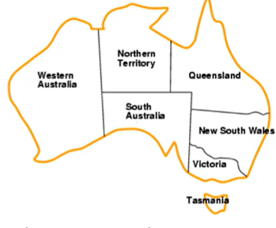
1.3 · EXAMPLE 1
Map colouring as a CSP
Problem statement: color each region eigher red, green , blue in such a way that no neighboring regions have the same color.
Constraint Programming · Chapter 1
11

Slide 12
1.3 · COMPLEXITY
Why not simply try every assignment?
A CSP with n variables and domains of size d has dⁿ complete assignments.
256
16.7 million
10⁸
≈ 10²⁹⁵
4-queens: 4⁴
8-queens: 8⁸
SEND+MORE: 10⁸
200 courses in 30 slots: 30²⁰⁰
Deciding whether a CSP has a solution is NP-complete in general. CP avoids most of the space through propagation and smart search (Chapters 3–4).
Constraint Programming · Chapter 1
13

Slide 13
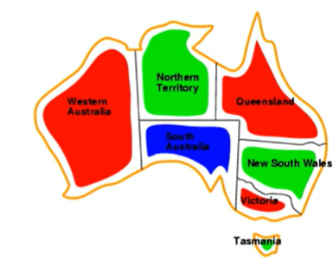
1.3 · EXAMPLE 1
Map colouring as a CSP
Problem statement: color each region eigher red, green , blue in such a way that no neighboring regions have the same color.
 | Model
X-Variables | WA, NT, SA, Q, NSW, V, T
D- Domains | {red, green, blue} for each variable
C- Contsrains | adjacent regions must have different color WA≠NT, WA≠SA, NT≠SA, NT≠Q, SA≠Q, SA≠NSW, SA≠V, Q≠NSW, NSW≠V
One solution: WA = red, NT = green, SA = blue, Q = red, NSW = green, V = red, T = green.
Constraint Programming · Chapter 1
12

Slide 14
1.4 · APPLICATIONS
Where constraint programming is used
INDUSTRY
EDUCATION · HEALTH
Planning & scheduling
Timetabling
Jobs on machines, project tasks, maintenance plans. Variables: start times; constraints: precedence, capacity.
University courses and exams, nurse rostering. Variables: slots and rooms; constraints: no clashes, availability.
PRODUCTS
NETWORKS · CLOUD
Configuration
Resource allocation
Computers, cars, product lines. Variables: components; constraints: compatibility rules.
Frequency assignment, virtual machine placement, vehicle routing. Constraints: capacity, interference.
Constraint Programming · Chapter 1
14

Slide 15
Thank you!!!
في أمان الله
Constraint Programming · Chapter 1
15

